Slide 1

Air Pollution and Respiratory Diseases
GROUP MEMBERS: Jessica E, Ariana G, Loraine G, Paul S, Deborah D

Slide 2
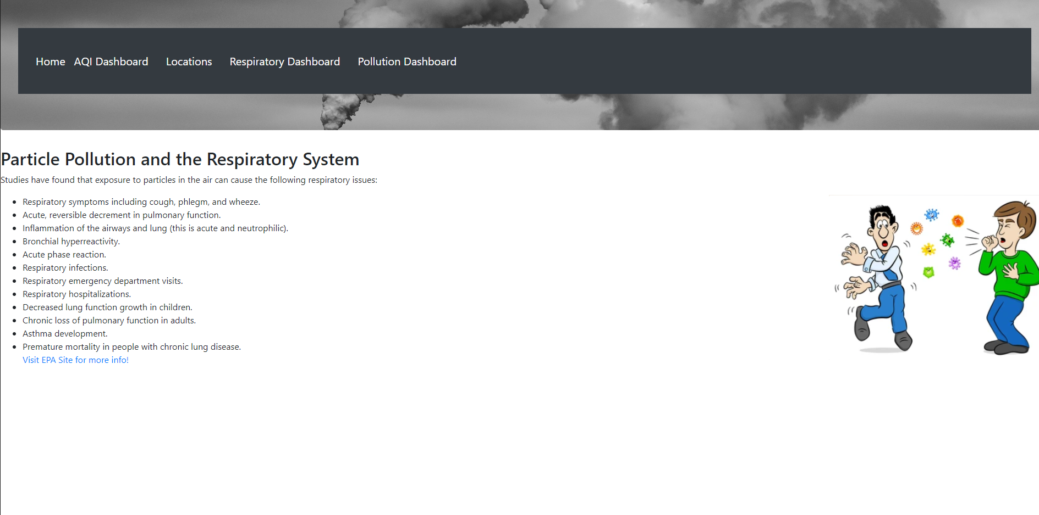
Home Page:
Gives a brief description of the respiratory illnesses and diseases that can be caused by air pollution.
Nav Bar will take you to various charts.

Slide 3
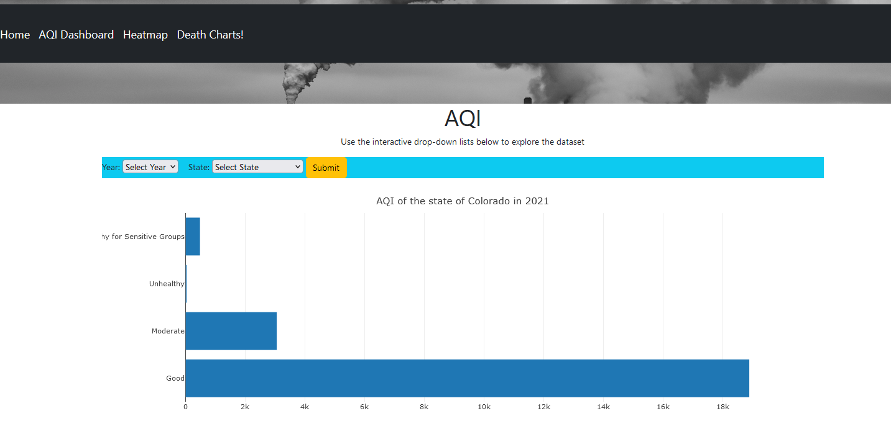
The AQI Dashboard Menu Option redirects to the plotly interactive map that allows a user to select a year and state to discover how many hours in that year the air quality fell into the various AQI index categories

Slide 4
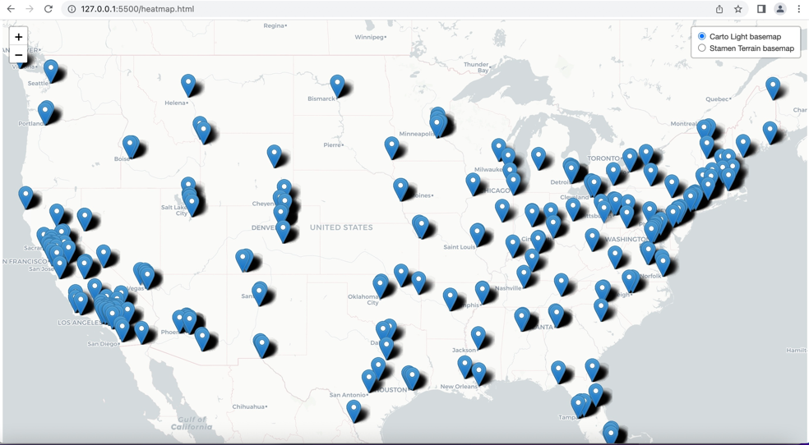
The Heatmaps menu item will take the user to the map of the USA displaying where air quality is located and the measurement.

Slide 5
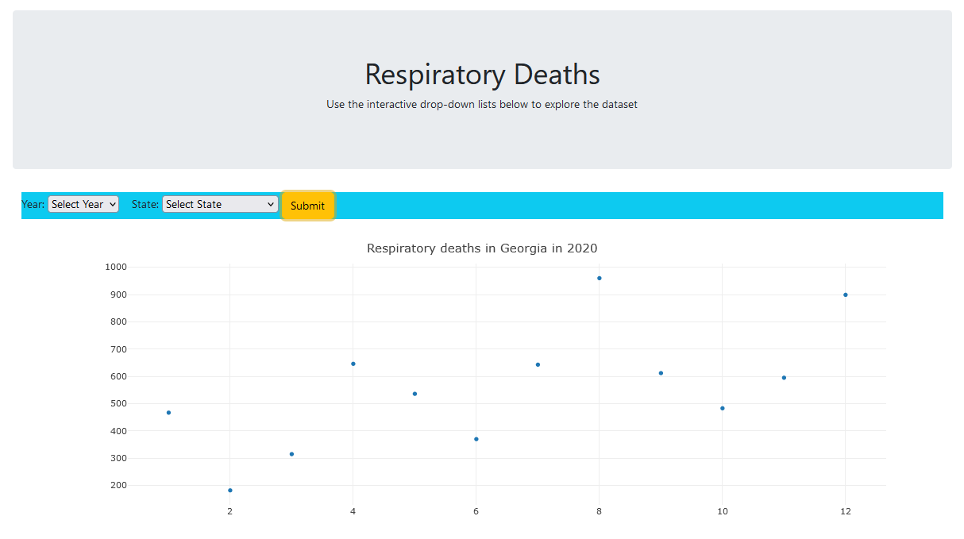
The ! Menu option redirects to a Plotly chart that displays the count of all respiratory deaths in a selected year within a selected state.

